Slide 1
Compute Shaders

Slide 2
Compute shaders
General purpose shaders that can be launched on the GPU
Called “Dispatching”
Not part of the rendering pipeline
No inherent input or output
Can read from textures, buffers, etc.
Can write to textures, buffers, etc.

Slide 3
“General purpose”?
Vertex & pixel shaders have specific uses:
Transform vertices
Calculate pixel colors
VS/PS are great for certain operations:
Drawing 3D objects
Drawing 2D sprites (on triangles)
Post Processing
Compute shaders do not have a singular use

Slide 4
When do compute shaders run?
Not during the rendering pipeline
IA > VS > RS > PS > OM
No compute shader stage
They can run any other time:
Between drawing things
While the GPU is otherwise idle
So how do they help us render stuff?

Slide 5
What can compute shaders do?
Anything HLSL can do:
Sample textures
Read arbitrary data from buffers
Lots and lots of math
Plus: Write arbitrary data into buffers
Textures (buffers of pixels)
Vertex buffers
Index buffers
Unordered access buffers (New!)

Slide 6
New resource: Unordered Access Buffer
Allow arbitrary & simultaneous access
Both read and write
From multiple GPU threads (executions of a shader)
Can only be use in pixel and compute stages
Append/Consume buffers
Special type of unordered access buffer
Like a stack: Can append (push) and consume (pop)

Slide 7
Data buffer views – SRV & UAV
Shader Resource Views (SRVs)
Work the same as in other shaders
Required for texture sampling
New: Unordered Access View (UAV)
Can wrap textures or unordered access buffers
Allows indexed data access (read or write)
device->CreateUnorderedAccessView(…)

Slide 8
UAVs & buffers - Options
Has 3 possible flags when used with buffers
Raw: Buffer contains raw, unstructured data
Append: Buffer used as append/consume
Counter:
Adds a special counter (integer) to the buffer
Can increment and decrement counter in shader
Useful for counting across threads
(Still only on the GPU)

Slide 9
Parallelism in compute shaders
Vertex shader runs for each vertex
Pixel shader runs for each rasterized pixel
How many compute shader threads run?
Up to you!
Can launch as many threads as necessary
You define the size of each thread group
And then launch N number of groups
More on this later

Slide 10
When to use compute shaders
Whenever parallelism is useful
Performing the same operations on each element
Lots and lots of math!
Procedurally creating/updating a texture
Updating particles
Fluid simulation
Post processing

Slide 11
Compute shader limitations
It’s still a shader running on a GPU
Meaning it’s not great at:
Conditional branching
GPU -> CPU copy (causes a pipeline stall)
Best when results are only needed by the GPU
Much like other shader “results”

Slide 12
Compute shader syntax
A basic (empty) compute shader:
Valid – it just doesn’t do anything
[numthreads(8, 8, 1)]
void main( uint3 threadID : SV_DispatchThreadID )
{
}

Slide 13
Defining thread group size
[numthreads(8, 8, 1)]
Defines the dimensions of the thread groups
Can have N number of threads per dimension
Why?
Ease of use & organization
We often work with 1D, 2D or 3D buffers
Easier if our thread IDs match those dimensions

Slide 14
Threads vs. thread groups
Thread
A single thread of execution
One “instance” of the compute shader
Will receive a unique ID per thread
Thread Group
A batch of threads running in parallel
You dispatch N thread groups from C++
Each group has some number of threads
As denoted by [numthreads(x,y,z)] in the shader

Slide 15
Thread group size - Best practices
Ideal to dispatch multiple groups
Rather than one huge group
Many GPU’s can handle group sizes of 64
Very small group sizes isn’t great
One thread group runs per hardware shader unit
Small groups = poor hardware saturation
Exact optimal sizes are hardware dependent
Test on your GPU, adjust as necessary

Slide 16
Compute shader function
[numthreads(8, 8, 1)]
void main( uint3 threadID : SV_DispatchThreadID )
{
}
Thread group size (required)
SV_DispatchThreadID
Unique ID combo per thread
ID’s have multiple dimensions
Great for indexing into textures or buffers
Return type is always void

Slide 17
HLSL – Textures in Compute
// Defined as usual
Texture2D myTex : register(t0);
// In main() -------------------
// Must use SampleLevel()
// No auto mip-mapping – you specify level
float4 c = myTex.SampleLevel(sampler, uv, 0);
// Or index into texture w/ int2 “coord”
float4 c2 = myTex[threadID.xy];

Slide 18
HLSL – StructuredBuffer in Compute
struct Vertex {
float3 Position;
float2 UV;
};
// Can define structured buffers (UAV)
StructuredBuffer<Vertex> verts : register(u0);
// In main() ------------------------
// Index into the buffer based on thread ID
Vertex v = verts[threadID.x];

Slide 19
HLSL - Buffers for “output”
Can define ReadWrite buffers & textures
Can be written to in the compute shader
Require a type parameter
// ReadWrite buffers are UAV’s
RWTexture2D<float4> outTex : register(u0);
RWStructuredBuffer<Vertex> verts : register(u1);
RWStructuredBuffer<int> numbers : register(u2);
Vertex v = ... // Set up a vertex
verts[threadID.x] = v; // Put into the buffer

Slide 20
The future: Asynchronous compute
Dispatching compute shaders while the GPU is doing other work
More fully saturates the GPU
Fills up idle cores with work
Ex: Update particles while making shadow map
Requires you to perform synchronization
Make sure all work is completed before moving on
Supported by DX12, Vulkan, PS4, Xbox One

Slide 21

Compute to the extreme
Dreams by Media Molecule (talk)
All compute shaders – no triangle rasterization
“Ray march” through signed distance fields on GPU

Slide 22
Case Study: Compute Shader Particles

Slide 23
Particle Systems
3 main phases: Emit, Update, Draw
Usual bottlenecks:
Emitting & updating lots of particles
Getting new particle data to GPU
How can compute shaders help?

Slide 24
Compute particles - Overview
Particles are just structs of data
Position, velocity, age, color, etc.
A buffer of them is basically a structured buffer
Something compute shaders can handle!
Particles on the GPU?
Need a buffer to hold max particles
Need a shader to “emit” (change some data)
Need a shader to “update” (change more data)
Need a shader to draw (using data already on GPU)

Slide 25
One such approach
Compute-Based GPU Particle Systems
From GDC 2014
Slides available
http://twvideo01.ubm-us.net/o1/vault/GDC2014/Presentations/Gareth_Thomas_Compute-based_GPU_Particle.pdf
Covers some advanced features too
Particle collisions on GPU
Parallelized sorting
Tiled rendering

Slide 26

GPU particle system - Buffers
Particle Pool – Actual particle data
Dead List – Indices of “dead” particles
Sort List
Indices of particles to draw
And their distances from camera, for sorting

Slide 27
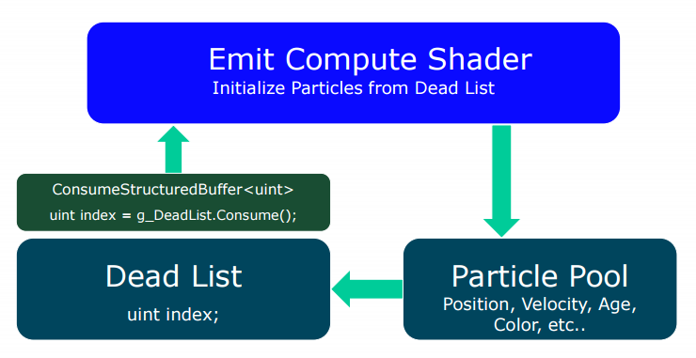
Emitting particles with a shader
1. Launch shader N times (N = # of particles to emit)
2. Each thread consumes a single index from dead list
This is the index of the particle this thread will “emit”
3. Create particle w/ fresh data (age = 0)
Write it into the particle pool at specified index

Slide 28
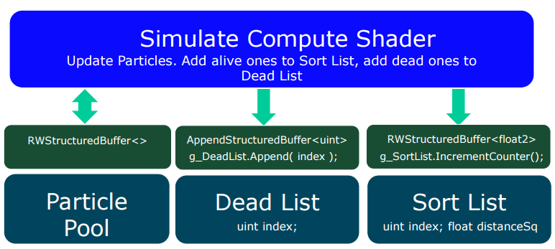
Updating particles with a shader
Each thread updates a single particle.
Use thread ID to get particle data
Update each particle based on delta time
Particle still alive? Add to sort (draw) list
Particle now dead? Append index to dead list

Slide 29
Closer look at Sort List
Basically the “draw list”
Has indices of particles to draw
In no particular order
Buffer made with “counter” flag
Each thread increments hidden counter
Allows each thread to get a unique, sequential ID
Used to “fill up” sort list from beginning each frame
CPU must reset this counter once per frame

Slide 30
Drawing particles
Problem:
Need to tell pipeline how many vertices to draw
But could be a different number each frame!
Which “thing” knows the right answer?
The sort list!
Well, it’s “hidden counter”
After update, it’s hidden counter = amount to draw
Can’t just copy back to CPU with huge performance penalty though…

Slide 31
Context->DrawInstancedIndirect()
Solution: We can do an indirect draw!
Usually we pass in number of vertices to draw
context->Draw(<some number>, …)
Plus other parameters (offsets, etc.)
However, we can tell DirectX to pull those parameters from a buffer already on GPU
Literally just a buffer with several integers

Slide 32
Getting data into indirect arg buffer
How can we execute arbitrary code on GPU?
Another compute shader!
This time with exactly 1 thread
A shader to do exactly one thing:
Get sort list’s hidden counter
Put that data into another buffer
Once that’s done, we can do an indirect draw

Slide 33
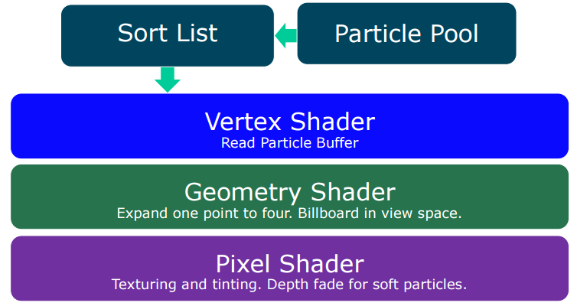
Actually drawing particles
Use vertex ID to get particle index from sort list
Look up particle data from pool
Send draw data (position, color, etc) down pipeline

Slide 34
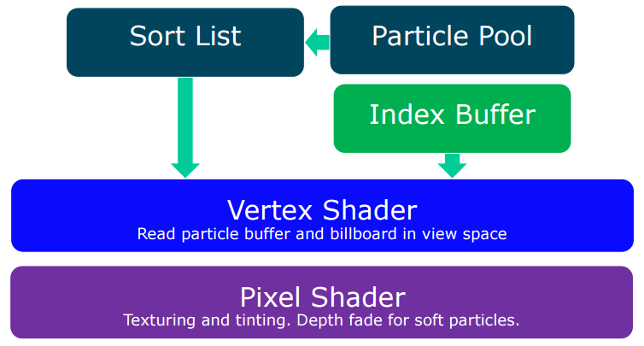
Even faster drawing – No GS
Can skip geometry shader if we…
Build smarter vertex shader (particle_id = V_ID / 4)
Tell pipeline to draw 4x vertices than particles
Use an index buffer to map 4 verts -> 2 triangles

Slide 35
Review: Requirements
4 buffers required:
Particle Pool: Buffer of Particle structs
Dead List: Unsigned integers
Sort List: Unsigned ints (could also have sort data)
Draw Args: 6 unsigned ints for indirect draw
3 compute shaders required:
Emit, Update & CopyDrawCount
Other shaders:
Vertex, Pixel and potentially Geometry

